Slide 1


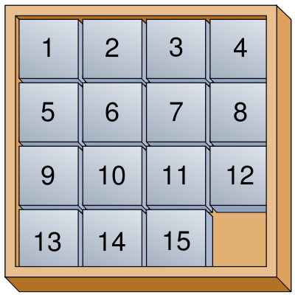







Introduction to Mathematical Foundation for Computer Science
Lecture 1: Sep 1

Slide 2
Basic Information
Course accesspage:
https://nitwarangal.webex.com/nitwarangal/j.php?MTID=m31b3f8a36c8ba6d83d10338569876375
Instructor: Dr. Ramalingaswamy Cheruku
Lectures per week: 4

Slide 3
Course Material
Book: Discrete Mathematical Structures with Applications to Computer Science,
Authors: J. P.Tremblay and P. Manohar, Tata McGraw Hill.
Book: Discrete Mathematics and its Applications with Combinatorics and Graph Theory,
Authors: K. H. Rosen, 7th Edition, Tata McGraw Hill.
Book: Discrete Mathematics for Computer Scientists and Mathematicians,
Authors: J. L. Mott, A. Kandel, T.P. Baker, 2nd Edition, Prentice Hall of India.
Book: Elements of Discrete Mathematics-A Computer Oriented Approach,
Authors: C. L. Liu and D. P. Mohapatra, 3rdEdition, Tata McGraw Hill.

Slide 4
Course Requirements
Minor-1 10%
Midterm, 30%
Minor-2, 10%
Final Exam, 40% to 50%

Slide 5
Why Mathematics?
Design efficient computer systems.
How did Google manage to build a fast search engine?
What is the foundation of internet security?
algorithms, data structures, database,
parallel computing, distributed systems,
cryptography, computer networks…
Logic, number theory, counting, graph theory…

Slide 6
Syllabus
Mathematical Logic: Propositional Calculus & Predicate Calculus
Combinatorics:
Recurrence Relations
Graph Theory:
Set Theory:
Algebraic Structures and
Number Theory (if time permits)

Slide 7

Topic 1: Logic and Proofs
How do computers think?
Logic: propositional logic, first order logic
Proof: induction, contradiction
Artificial intelligence, database, circuit, algorithms

Slide 8
Topic 2: Number Theory
Number sequence
Euclidean algorithm
Prime number
Modular arithmetic
Cryptography, coding theory, data structures

Slide 9
Topic 3: Counting
Sets
Combinations, Permutations, Binomial theorem
Functions
Counting by mapping, pigeonhole principle
Recursions, generating functions
Probability, algorithms, data structures

Slide 10
Topic 3: Counting
How many steps are needed to sort n numbers?

Slide 11
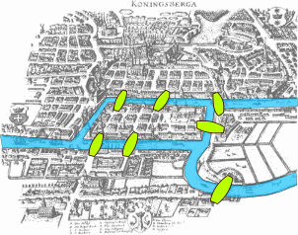
Topic 4: Graph Theory
Relations, graphs
Degree sequence, isomorphism, Eulerian graphs
Trees
Computer networks, circuit design, data structures

Slide 12
What is discrete mathematics?
Logic: artificial intelligence (AI), database, circuit design
Number theory: cryptography, coding theory
Counting: probability, analysis of algorithm
Graph theory: computer network, data structures
logic, sets, functions, relations, etc
CSC 2100, ERG 2040, CSC 3130, CSC 3160

Slide 13
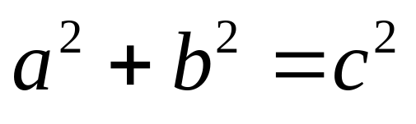
Pythagorean theorem
c
b
a
Familiar?
Obvious?

Slide 14
Good Proof
b
c
a
Rearrange into: (i) a c×c square, and then
(ii) an a×a & a b×b square

Slide 15
Good Proof
c
b-a
c
c
a
b
c

Slide 16
Good Proof
b
c
b-a
a
b-a

Slide 17
Good Proof
a
b
a
b-a
a
b
74 proofs in http://www.cut-the-knot.org/pythagoras/index.shtml

Slide 18
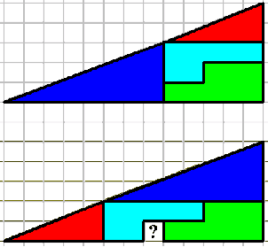
Bad Proof

Slide 19
Statement (Proposition)
Statement is either True or False
Examples:
2 + 2 = 4
True
3 x 3 = 8
False
787009911 is a prime
Non-examples:
Hello.
How are you?

Slide 20
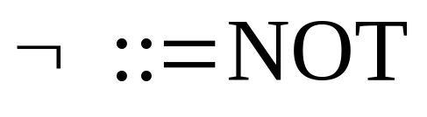
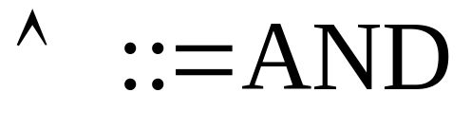
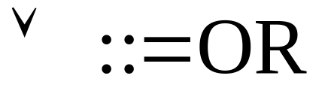


Logic Operators
P
Q
P Q
P
Q
P Q

Slide 21
Compound Statement
p = “it is hot”
q = “it is sunny”
It is hot and sunny
It is not hot but sunny
It is neither hot nor sunny

Slide 22
Exclusive-Or

coffee “or” tea
exclusive-or
How to construct a compound statement for exclusive-or?
p | q | p  q

Slide 23
Check by Truth Table
p | q

Slide 24
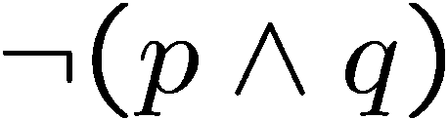
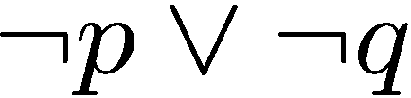


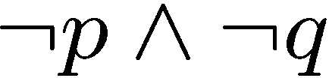
Logical Equivalence
Two statements have the same truth table
De Morgan’s Law
De Morgan’s Law

Slide 25
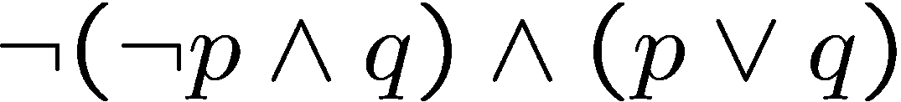
Simplifying Statement
A tautology is a statement that is always true.
A contradiction is a statement that is always false.

Slide 26
Two Important Things
http://appsrv.cse.cuhk.edu.hk/~acmprog/web2008/
Class Photos! Identify your face and send us your name and nicknames

